Slide 1

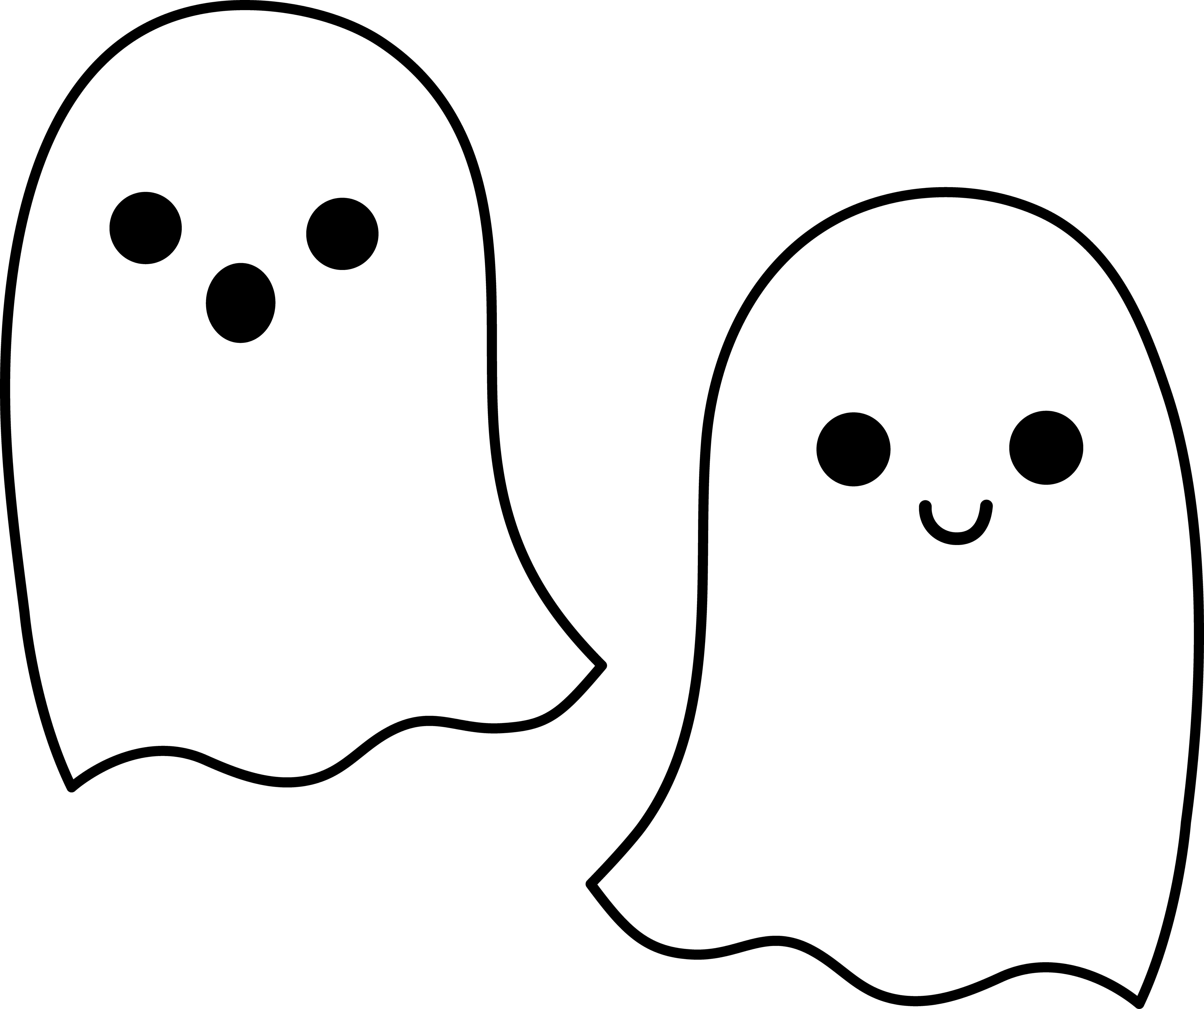
Regression From Causality to Prediction (and back again)
We use observational comparisons to make causal claims! OooOoOOoOooh!
Dealing with Data, Class 5

Slide 2
Announcements
Please take candy!
HW4 out now!
Due in a week!
Project-thinking-time will start soon!
See syllabus (on Blackboard) for some info about the project
By next week we’ll release more information, project suggestions, etc
We encourage you to collaborate in groups (up to 4) on the project!

Slide 3
Agenda
Recap
Matching Estimators and “Controlling” for Variables
Linear Models
Regression and Interpretation
Propensity Scores (if time)

Slide 4
Recap

Slide 5
The Story So Far...
Causality!
Defined as a “counter-factual” notion
If we want to establish it, we need some random(ish)-ness
Randomized Control Trials
Natural Experiments

Slide 6
Other approaches to causality?
From Class 1: Several notions of causality
Regularity-based
Law-based
Counterfactual-based
“Pass”
Establishing Causality is often important, but...
Sometimes all we want to do is prediction
You’re going to make about $X when you grow up.
Is it “because” you went to college? I don’t know.
Doing prediction can actually help us establish causality!
We’ll see this later today.
We’ve been here
We’re going here

Slide 7


Today: From Causality to Prediction
Regression!
D
Z
Y
Prediction-Land
Causality-Land

Slide 8
Matching on observables

Slide 9

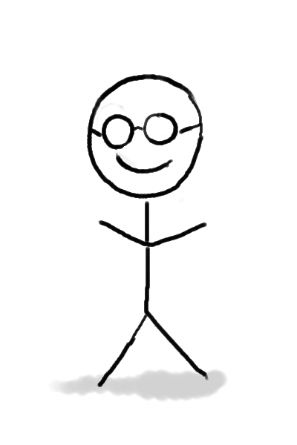
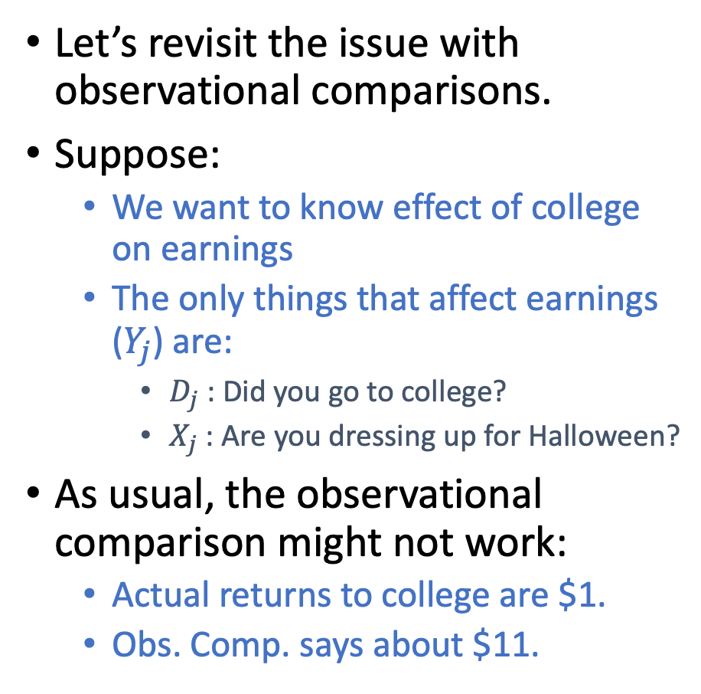
Back to causality-land
Truth:
$1
$2
Let’s revisit the issue with observational comparisons.
Suppose:
We want to know effect of college on earnings
The only things that affect earnings ($Y_{j}$) are:
$D_{j}$ : Did you go to college?
$X_{j}$: Are you dressing up for Halloween?
As usual, the observational comparison might not work:
Actual returns to college are $1.
Obs. Comp. says about $11.
$11
$12
About $1
About $12
If we don’t pay attention to costume:

Slide 10
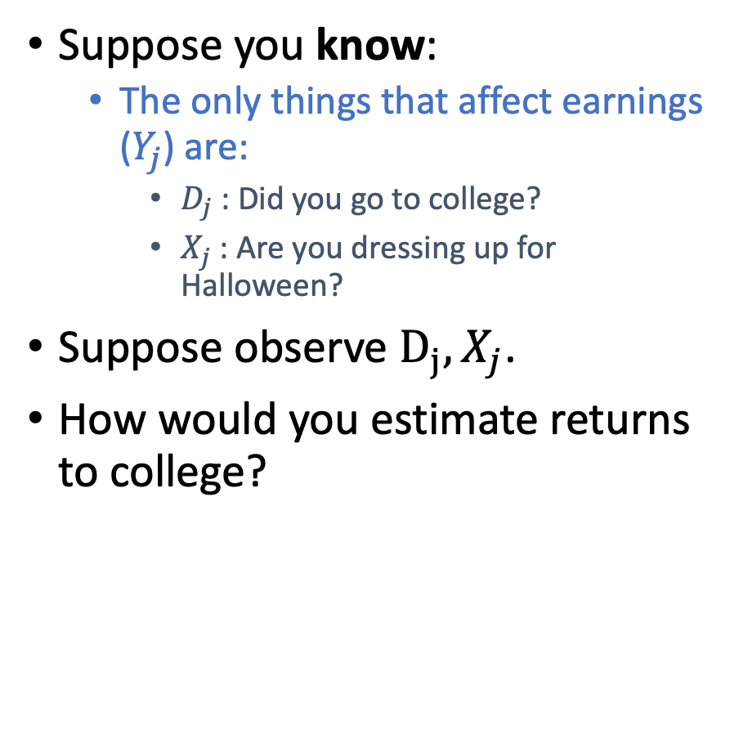
Back to causality-land
Truth:
$1
$2
Suppose you know:
The only things that affect earnings ($Y_{j}$) are:
$D_{j}$ : Did you go to college?
$X_{j}$: Are you dressing up for Halloween?
Suppose observe $D_{j}, X_{j}$.
How would you estimate returns to college?
$11
$12
About $1
About $12
If we don’t pay attention to costume:

Slide 11
Back to causality-land
Truth:
$1
$2
How would you estimate returns to college?
Look at the average in each square.
Compute returns to college among the costumed group.
Compute returns to college among non-costumed group.
$11
$12
About $1
About $12
If we don’t pay attention to costume:

Slide 12
In prediction-land
Truth:
$1
$2
I didn’t go to college.
I am dressing up for Halloween.
$11
$12
How much would you predict this person makes?
About $11
About $1
About $12
If we don’t pay attention to costume:

Slide 13
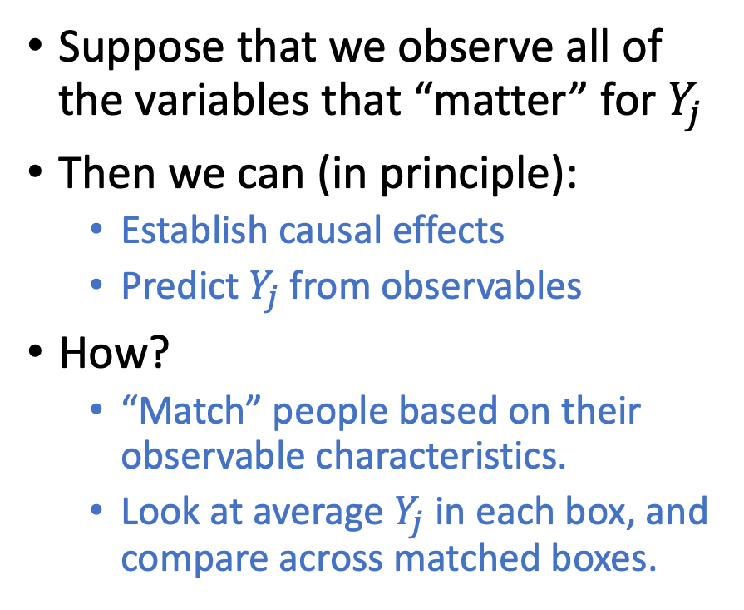
Matching on observables
Doing this comparison “controls for” everything other than going to college.
$10
$2
Suppose that we observe all of the variables that “matter” for $Y_{j}$
Then we can (in principle):
Establish causal effects
Predict $Y_{j}$ from observables
How?
“Match” people based on their observable characteristics.
Look at average $Y_{j}$ in each box, and compare across matched boxes.
Went to college
Dressing up
Age 30-35
Male
Married
Likes broccoli
...
Didn’t go to college
Dressing up
Age 30-35
Male
Married
Likes broccoli
...
$13
$7
$3
$15
$6
$11
$9
$7

Slide 14
Is matching on observables a good idea? For causality?
Obvious issue: we may not observe everything that’s important.
One of the messages of HW2 is that this isn’t in general a good idea for causality.
BUT! If you have enough observables, some researchers are compelled by this. (e.g., with “twin studies”).
$1
$2
About $1
About $12
If we don’t have data about costume choices:
Truth:
$11
$12

Slide 15
Is matching on observables a good idea? For prediction?
Obvious issue: we may not observe everything that’s important.
Actually, this might be okay for prediction, depending on the goal.
We’ll predict accurately for most people.
$1
$2
About $1
About $12
If we don’t have data about costume choices:
Truth:
$11
$12

Slide 16
Is matching on observables a good idea? For prediction?
Obvious issue: we may not observe everything that’s important.
Here prediction doesn’t work.
BUT! We can tell it doesn’t work.
(Note that actually we can estimate causality in this example)
$1
$2
$5.5
$6.5
If we don’t have data about costume choices:
Truth:
$11
$12

Slide 17
Suppose we do want to match on observables Despite the caveat about what we observe
Other issues?

Slide 18
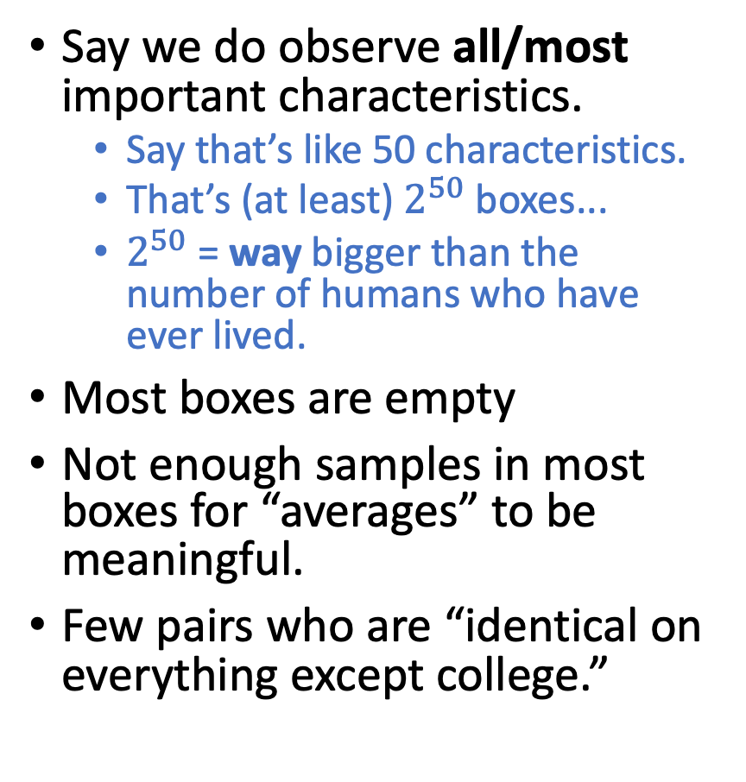
Issue: Too many boxes!
It’s lonely in here...
$10
No data
Say we do observe all/most important characteristics.
Say that’s like 50 characteristics.
That’s (at least) $2^{50}$ boxes...
$2^{50}$ = way bigger than the number of humans who have ever lived.
Most boxes are empty
Not enough samples in most boxes for “averages” to be meaningful.
Few pairs who are “identical on everything except college.”
Went to college
Dressing up
Age 30-35
Male
Married
Likes broccoli
...
Didn’t go to college
Dressing up
Age 30-35
Male
Married
Likes broccoli
...
$13
$3
$15
No data
$11
No data
No data
No data

Slide 19
Two fixes
Regression
Let’s make some assumptions about the world!
Propensity scores (if time)
Doing prediction helps us understand causality!

Slide 20
Regression!

Slide 21
But first, Linear Models!

Slide 22
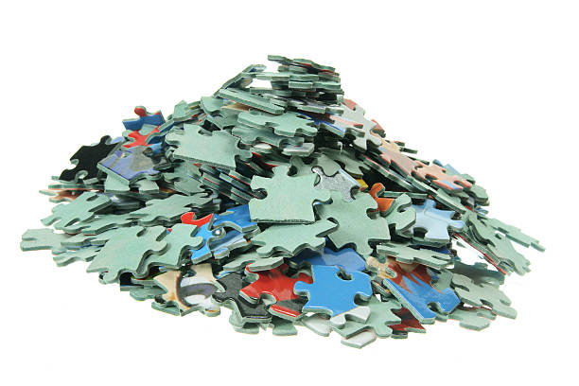
Suppose that the world is completely unstructured
There are no patterns to anything!
Terrifying!
OooOOOooOOoHhhOO

Slide 23
Suppose that the world is completely unstructured
Then we have no hope of solving our “too many boxes” problem.
Everyone is unique, and we can’t infer anything about anyone from anybody else!
You don’t know me, man!

Slide 24
Models
A model is a description of how (an aspect of) the world works.
It imposes assumptions about structure in the world.
“In my model of the world, if A and B have similar observable characteristics, they will likely have similar outcomes in the future.”
“In my model of the world, everyone has full information and acts rationally.”
“All models are wrong, but some are useful.” –George Box
Low-degree models
Deep neural networks
...
“The universe is a uniform void.”
Linear models
“Chaos! We can’t do anything!”
Sparse/Low-rank models
Universe
Simple
Complex

Slide 25
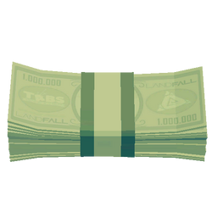
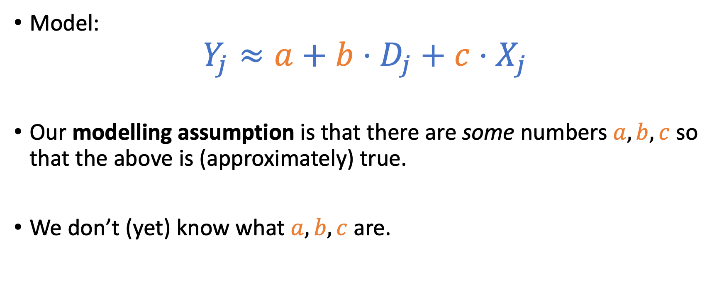
Linear models Definition by (our usual) example
Model:
$$Y_{j}≈a+b⋅D_{j}+c⋅X_{j}$$
Our modelling assumption is that there are some numbers $a,b,c$ so that the above is (approximately) true.
We don’t (yet) know what $a,b,c$ are.

Slide 26
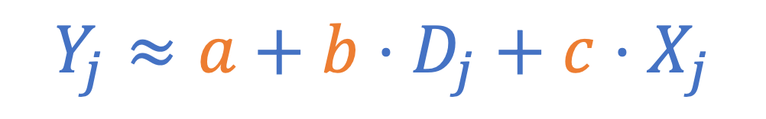
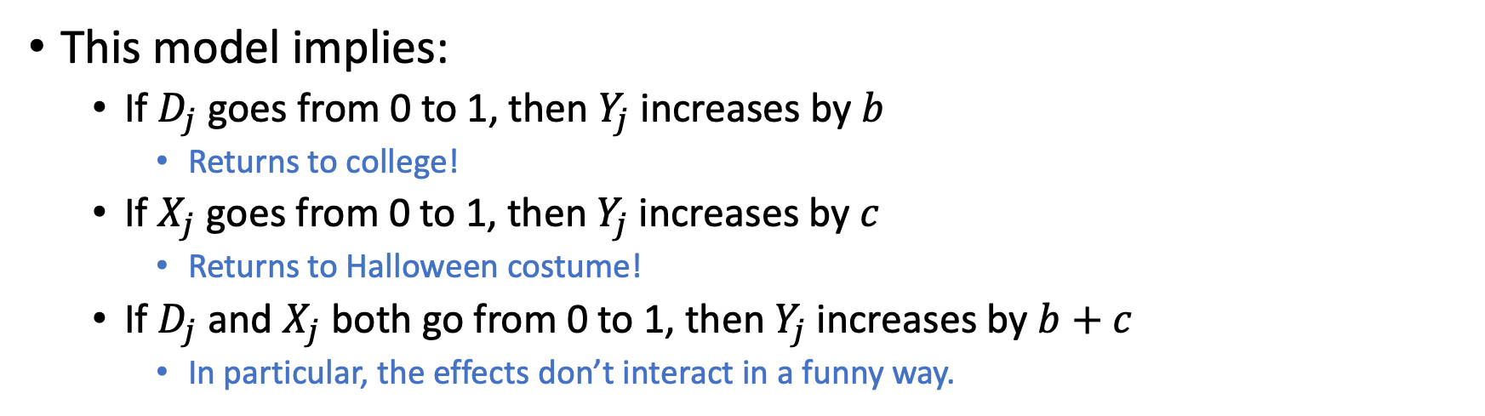
Why would we make this assumption? Intuitively, what does it mean?
$$Y_{j}≈a+b⋅D_{j}+c⋅X_{j}$$
This model implies:
If $D_{j}$ goes from 0 to 1, then $Y_{j}$ increases by $b$
Returns to college!
If $X_{j}$ goes from 0 to 1, then $Y_{j}$ increases by $c$
Returns to Halloween costume!
If $D_{j}$ and $X_{j}$ both go from 0 to 1, then $Y_{j}$ increases by $b+c$
In particular, the effects don’t interact in a funny way.

Slide 27
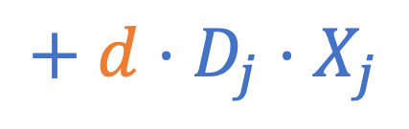
Why would we make this assumption? Intuitively, what does it mean?
$$Y_{j}≈a+b⋅D_{j}+c⋅X_{j}$$
$$+ d⋅D_{j}⋅X_{j}$$
Note: if we wanted to we could add an “interaction term” to our model.
This model implies:
If $D_{j}$ goes from 0 to 1, then $Y_{j}$ increases by $b$
Returns to college!
If $X_{j}$ goes from 0 to 1, then $Y_{j}$ increases by $c$
Returns to Halloween costume!
If $D_{j}$ and $X_{j}$ both go from 0 to 1, then $Y_{j}$ increases by $b+c$
In particular, the effects don’t interact in a funny way.

Slide 28
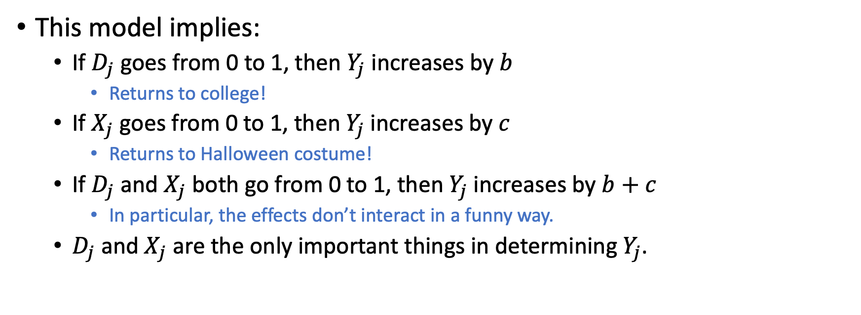
Why would we make this assumption? Intuitively, what does it mean?
$$Y_{j}≈a+b⋅D_{j}+c⋅X_{j}$$
This model implies:
If $D_{j}$ goes from 0 to 1, then $Y_{j}$ increases by $b$
Returns to college!
If $X_{j}$ goes from 0 to 1, then $Y_{j}$ increases by $c$
Returns to Halloween costume!
If $D_{j}$ and $X_{j}$ both go from 0 to 1, then $Y_{j}$ increases by $b+c$
In particular, the effects don’t interact in a funny way.
$D_{j}$ and $X_{j}$ are the only important things in determining $Y_{j}$.
If we think these are reasonable, then maybe this
is a reasonable model.
Even if we don’t think these are reasonable, it could still be interesting to work with this model, but we should be careful interpreting our results.

Slide 29
Okay now, Regression!
Aka, “Fitting a linear model.”

Slide 30
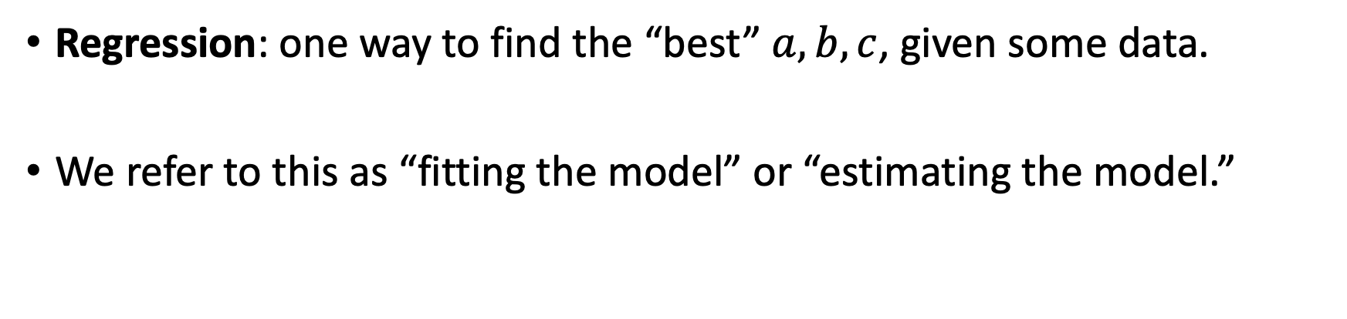
Say we have a reasonable linear model
$$Y_{j}≈a+b⋅D_{j}+c⋅X_{j}$$
Regression: one way to find the “best” $a,b,c$, given some data.
We refer to this as “fitting the model” or “estimating the model.”

Slide 31
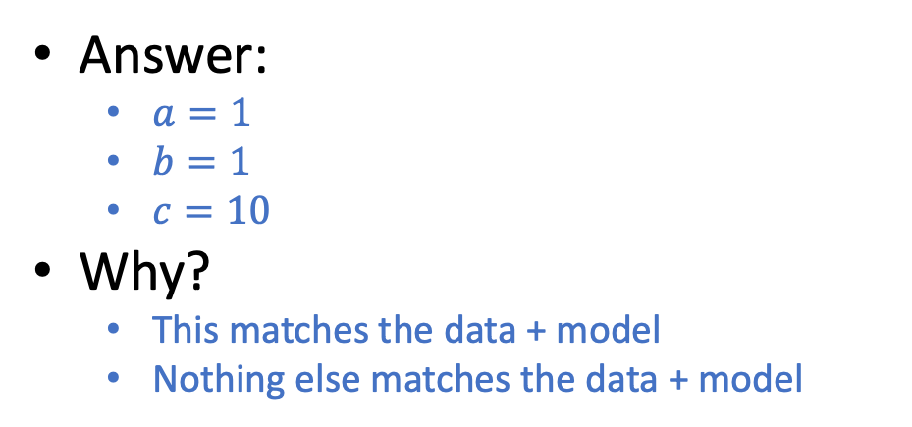
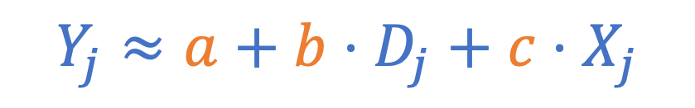
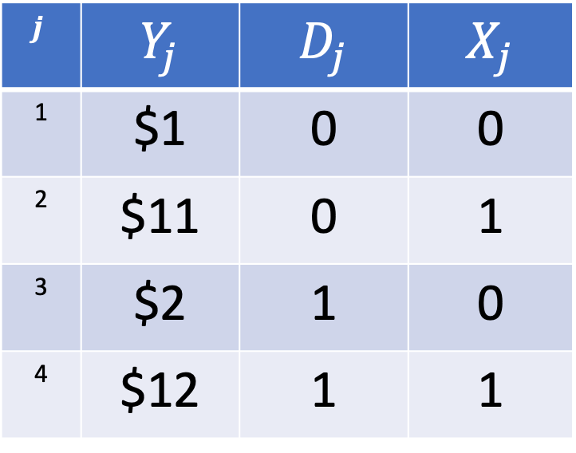
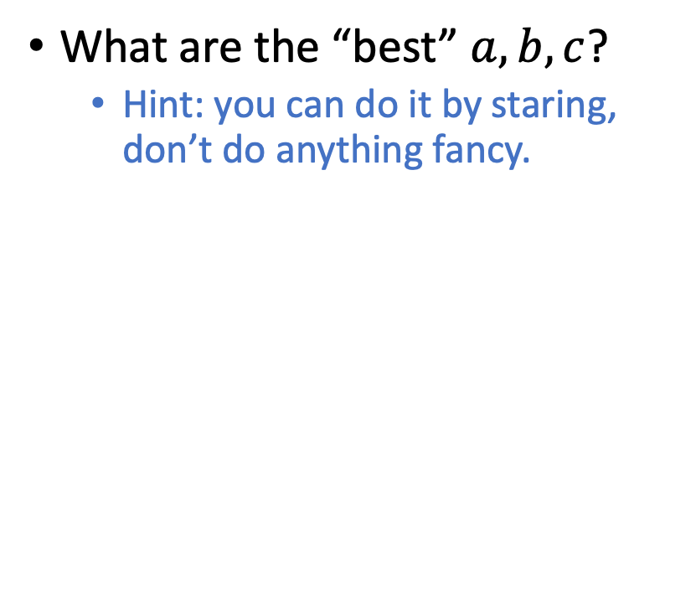
Example: You do regression!
Model:
What are the “best” $a,b,c$?
Hint: you can do it by staring, don’t do anything fancy.
$$Y_{j}≈a+b⋅D_{j}+c⋅X_{j}$$
Data:
$$j$$ | $$Y_{j}$$ | $$D_{j}$$ | $$X_{j}$$
1 | $1 | 0 | 0
2 | $11 | 0 | 1
3 | $2 | 1 | 0
4 | $12 | 1 | 1
Answer:
$a=1$
$b=1$
$c=10$
Why?
This matches the data + model
Nothing else matches the data + model

Slide 32
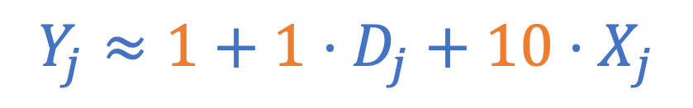
Example: You do regression!
Model:
What are the “best” $a,b,c$?
Hint: you can do it by staring, don’t do anything fancy.
$$Y_{j}≈1+1⋅D_{j}+10⋅X_{j}$$
Data:
$$j$$ | $$Y_{j}$$ | $$D_{j}$$ | $$X_{j}$$
1 | $1 | 0 | 0
2 | $11 | 0 | 1
3 | $2 | 1 | 0
4 | $12 | 1 | 1
Answer:
$a=1$
$b=1$
$c=10$
Why?
This matches the data + model
Nothing else matches the data + model

Slide 33

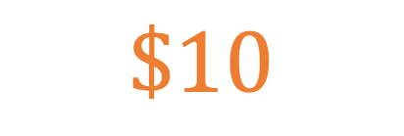
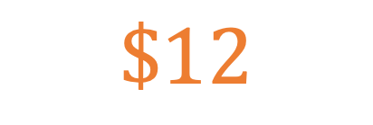
Example Continued
Model:
What is the ATE of going to college on earnings?
What is the ATE of dressing up for Halloween on earnings?
How much would you predict that someone who went to college and dressed up for Halloween?
$$Y_{j}≈1+1⋅D_{j}+10⋅X_{j}$$
$$\$1$$
Data:
$$j$$ | $$Y_{j}$$ | $$D_{j}$$ | $$X_{j}$$
1 | $1 | 0 | 0
2 | $11 | 0 | 1
3 | $2 | 1 | 0
4 | $12 | 1 | 1
$$\$10$$
$$\$12$$

Slide 34
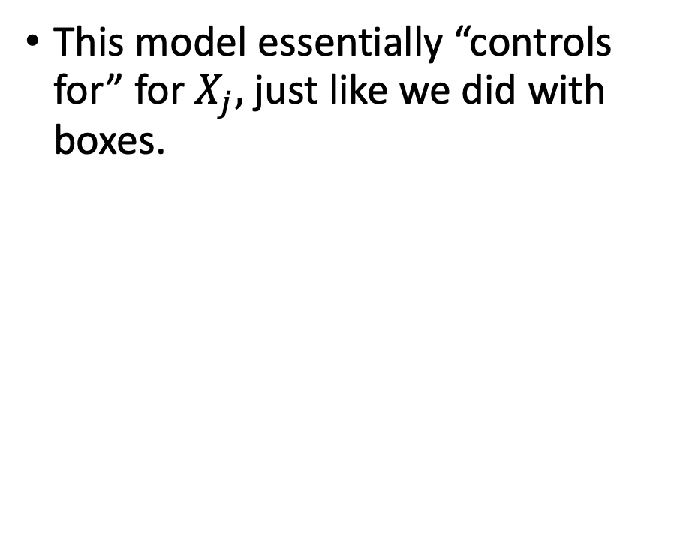
Relationship to boxes
Model:
This model essentially “controls for” for $X_{j},$just like we did with boxes.
$$Y_{j}≈1+1⋅D_{j}+10⋅X_{j}$$
Data:
$$j$$ | $$Y_{j}$$ | $$D_{j}$$ | $$X_{j}$$
1 | $1 | 0 | 0
2 | $11 | 0 | 1
3 | $2 | 1 | 0
4 | $12 | 1 | 1
$1
$2
$11
($12)
No Data

Slide 35
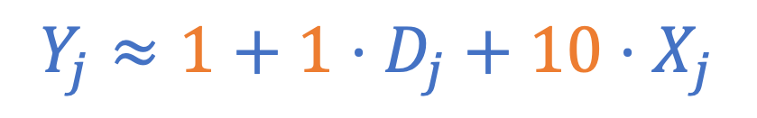
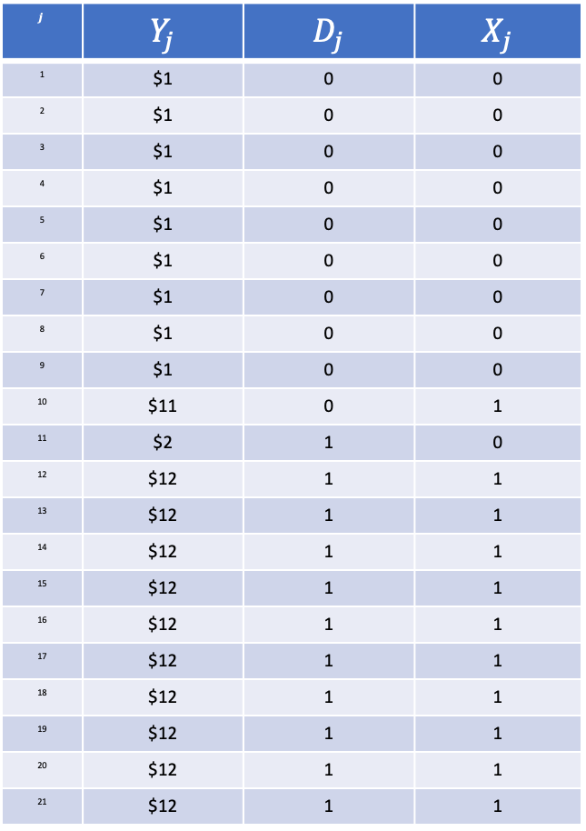
Relationship to boxes
Model:
$$Y_{j}≈1+1⋅D_{j}+10⋅X_{j}$$
Data:
$$j$$ | $$Y_{j}$$ | $$D_{j}$$ | $$X_{j}$$
1 | $1 | 0 | 0
2 | $1 | 0 | 0
3 | $1 | 0 | 0
4 | $1 | 0 | 0
5 | $1 | 0 | 0
6 | $1 | 0 | 0
7 | $1 | 0 | 0
8 | $1 | 0 | 0
9 | $1 | 0 | 0
10 | $11 | 0 | 1
11 | $2 | 1 | 0
12 | $12 | 1 | 1
13 | $12 | 1 | 1
14 | $12 | 1 | 1
15 | $12 | 1 | 1
16 | $12 | 1 | 1
17 | $12 | 1 | 1
18 | $12 | 1 | 1
19 | $12 | 1 | 1
20 | $12 | 1 | 1
21 | $12 | 1 | 1
This model essentially “controls for” for $X_{j},$just like we did with boxes.
$1
$2
Also works in this setting!
$11
$12

Slide 36
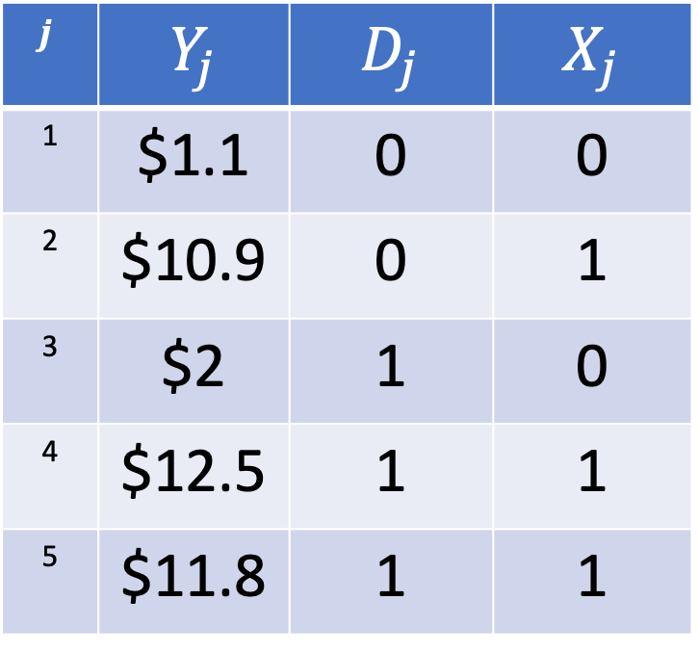
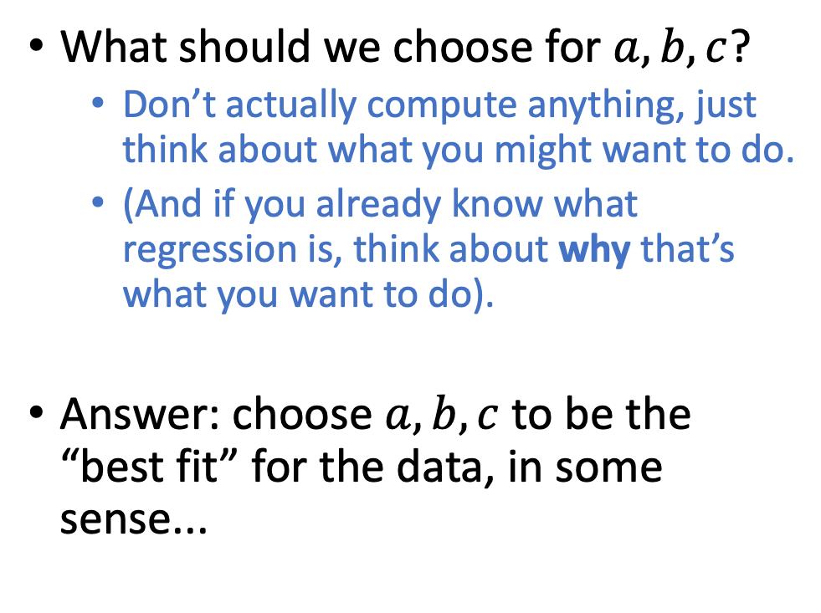
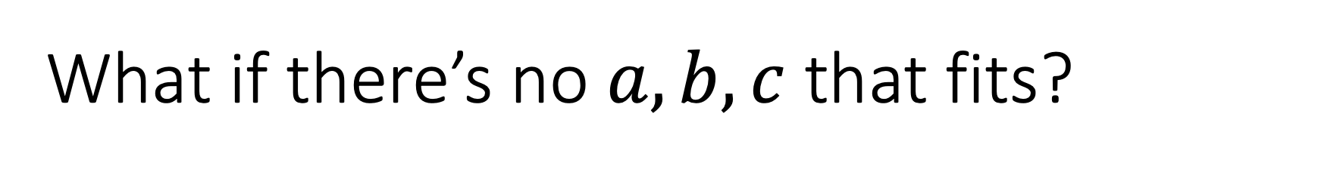
What if there’s no $a,b,c$ that fits?
What should we choose for $a,b,c$?
Don’t actually compute anything, just think about what you might want to do.
(And if you already know what regression is, think about why that’s what you want to do).
Answer: choose $a,b,c$ to be the “best fit” for the data, in some sense...
$$Y_{j}≈a+b⋅D_{j}+c⋅X_{j}$$
$$j$$ | $$Y_{j}$$ | $$D_{j}$$ | $$X_{j}$$
1 | $1.1 | 0 | 0
2 | $10.9 | 0 | 1
3 | $2 | 1 | 0
4 | $12.5 | 1 | 1
5 | $11.8 | 1 | 1

Slide 37


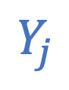
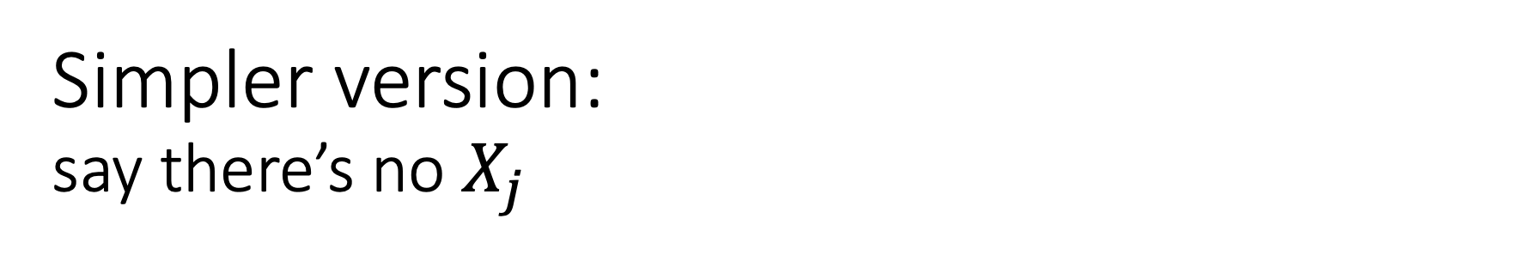
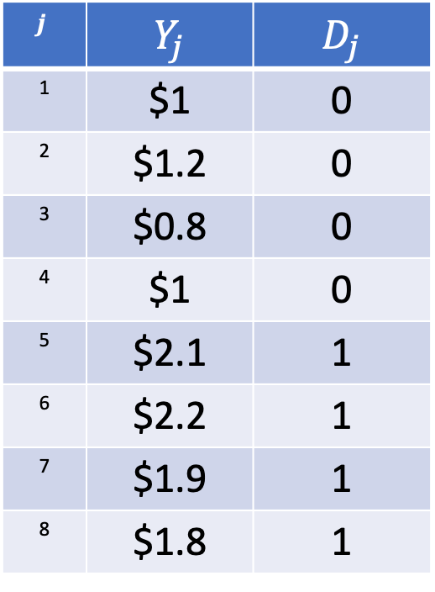
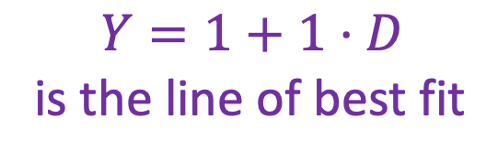
Simpler version: say there’s no $X_{j}$
$$Y_{j}≈a+b⋅D_{j}$$
Model:
Data:
$$j$$ | $$Y_{j}$$ | $$D_{j}$$
1 | $1 | 0
2 | $1.2 | 0
3 | $0.8 | 0
4 | $1 | 0
5 | $2.1 | 1
6 | $2.2 | 1
7 | $1.9 | 1
8 | $1.8 | 1
$$Y_{j}$$
2
$$Y=1+1⋅D$$
is the line of best fit
(Note: this is actually just the same as the observational comparison...why?)
1
0
1
$$D_{j}$$

Slide 38
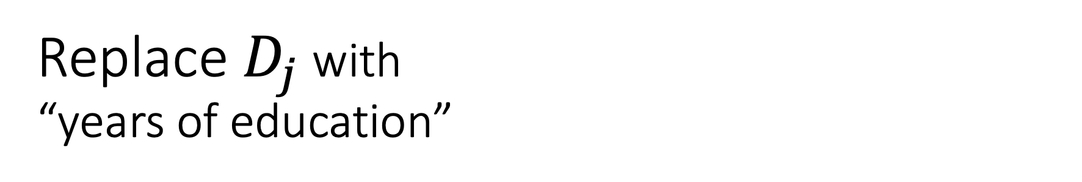
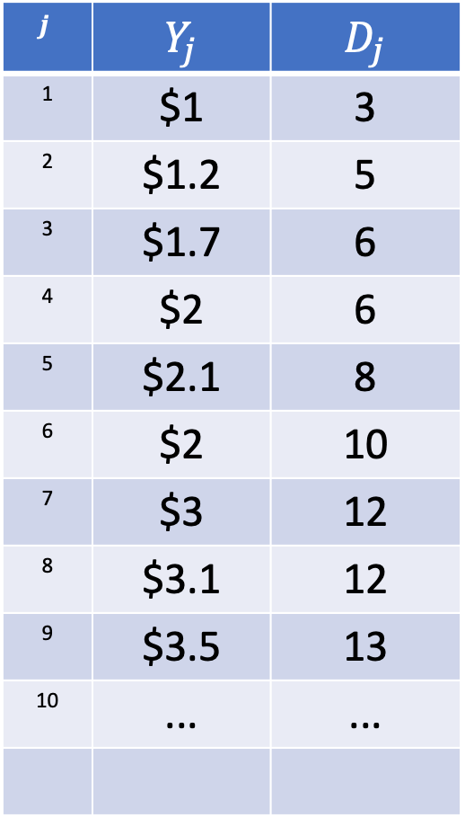
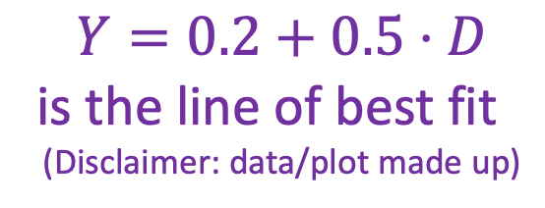
Replace $D_{j}$ with “years of education”
$$Y_{j}≈a+b⋅D_{j}$$
Model:
Data:
$$j$$ | $$Y_{j}$$ | $$D_{j}$$
1 | $1 | 3
2 | $1.2 | 5
3 | $1.7 | 6
4 | $2 | 6
5 | $2.1 | 8
6 | $2 | 10
7 | $3 | 12
8 | $3.1 | 12
9 | $3.5 | 13
10 | ... | ...
$$Y_{j}$$
$$Y=0.2+0.5⋅D$$
is the line of best fit
(Disclaimer: data/plot made up)
0
25
$$D_{j}$$

Slide 39

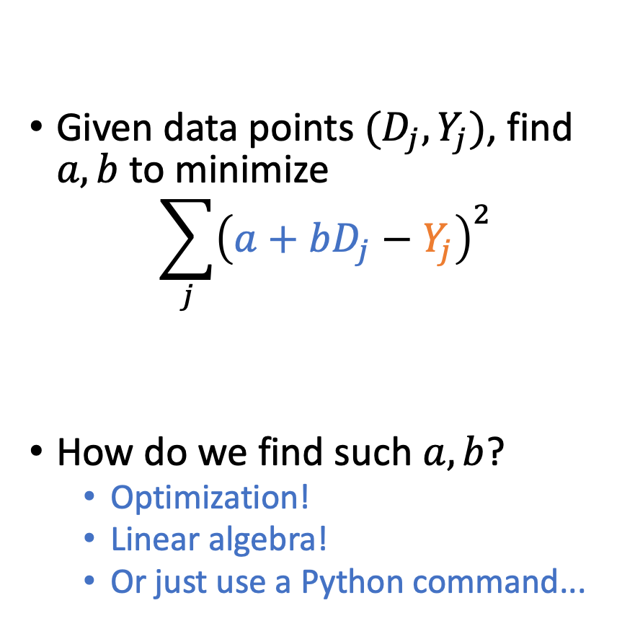
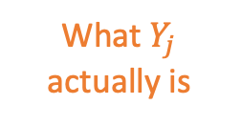
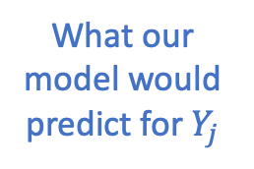

What does “line of best fit” mean?
Given data points $(D_{j}, Y_{j})$, find $a,b$ to minimize
$$\sum_{j}{{\left(a+bD_{j}−Y_{j}\right)}^{2}}$$
How do we find such $a,b$?
Optimization!
Linear algebra!
Or just use a Python command...
$$Y_{j}$$
What our model would predict for $Y_{j}$
What $Y_{j}$ actually is
0
25
$$D_{j}$$

Slide 40
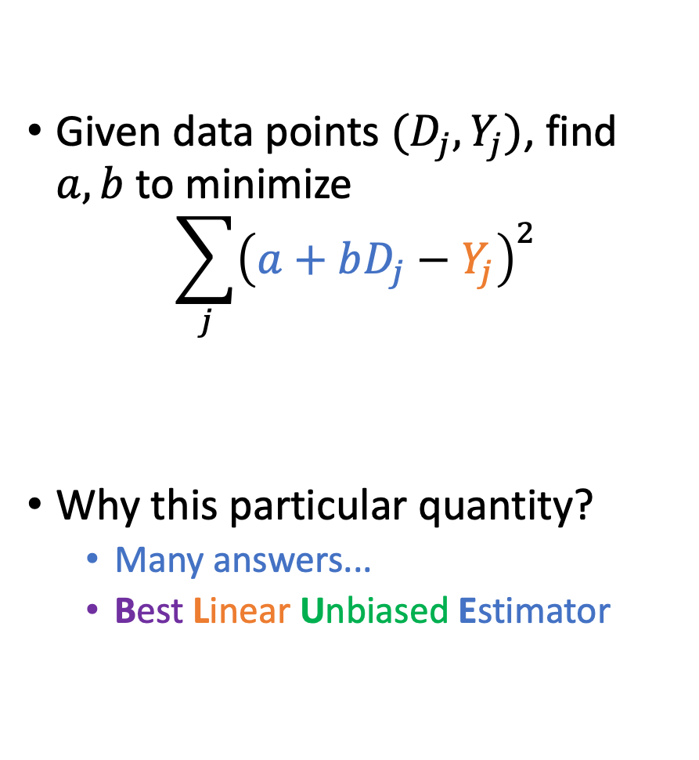
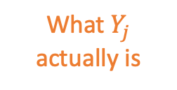
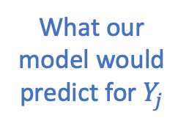
What does “line of best fit” mean?
Given data points $(D_{j}, Y_{j})$, find $a,b$ to minimize
$$\sum_{j}{{\left(a+bD_{j}−Y_{j}\right)}^{2}}$$
Why this particular quantity?
Many answers...
Best Linear Unbiased Estimator
$$Y_{j}$$
What our model would predict for $Y_{j}$
What $Y_{j}$ actually is
Minimizes variance
If we want to fit a linear model
and we don’t want to be systematically biased
0
25
$$D_{j}$$

Slide 41
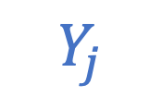
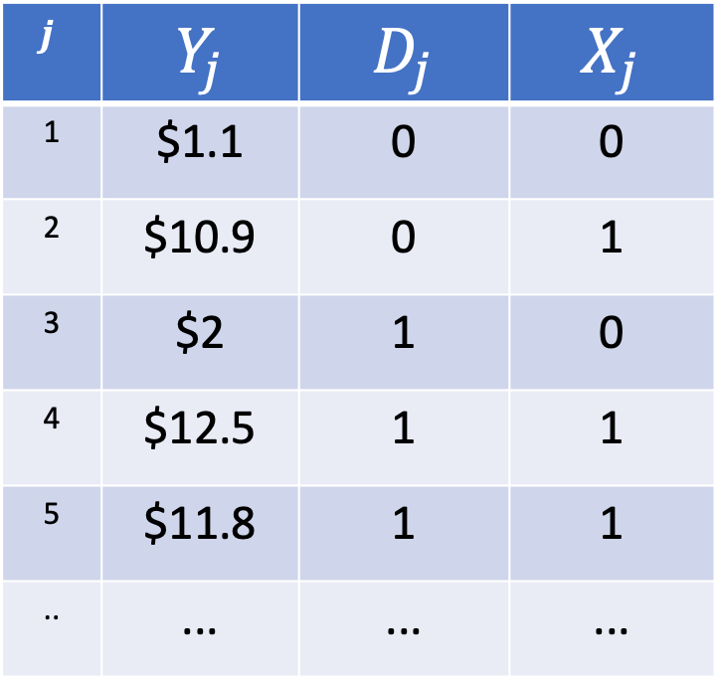
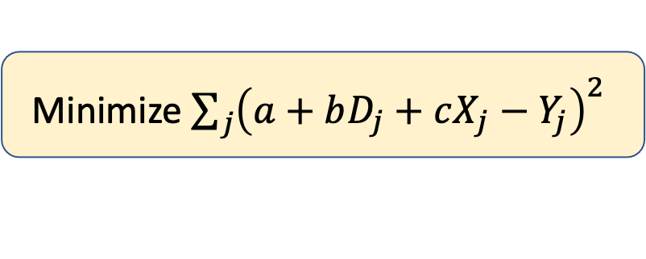
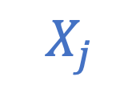
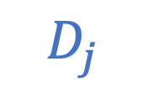
What if there’s no $a,b,c$ that fits?
But, we had more variables!
Generalization: plane of best fit.
$$Y_{j}$$
$$Y_{j}≈a+b⋅D_{j}+c⋅X_{j}$$
$$j$$ | $$Y_{j}$$ | $$D_{j}$$ | $$X_{j}$$
1 | $1.1 | 0 | 0
2 | $10.9 | 0 | 1
3 | $2 | 1 | 0
4 | $12.5 | 1 | 1
5 | $11.8 | 1 | 1
.. | ... | ... | ...
1
1
$$D_{j}$$
$$X_{j}$$
Minimize ${\sum_{j}{{\left(a+bD_{j}+cX_{j}−Y_{j}\right)}^{2}}}^{ }$

Slide 42
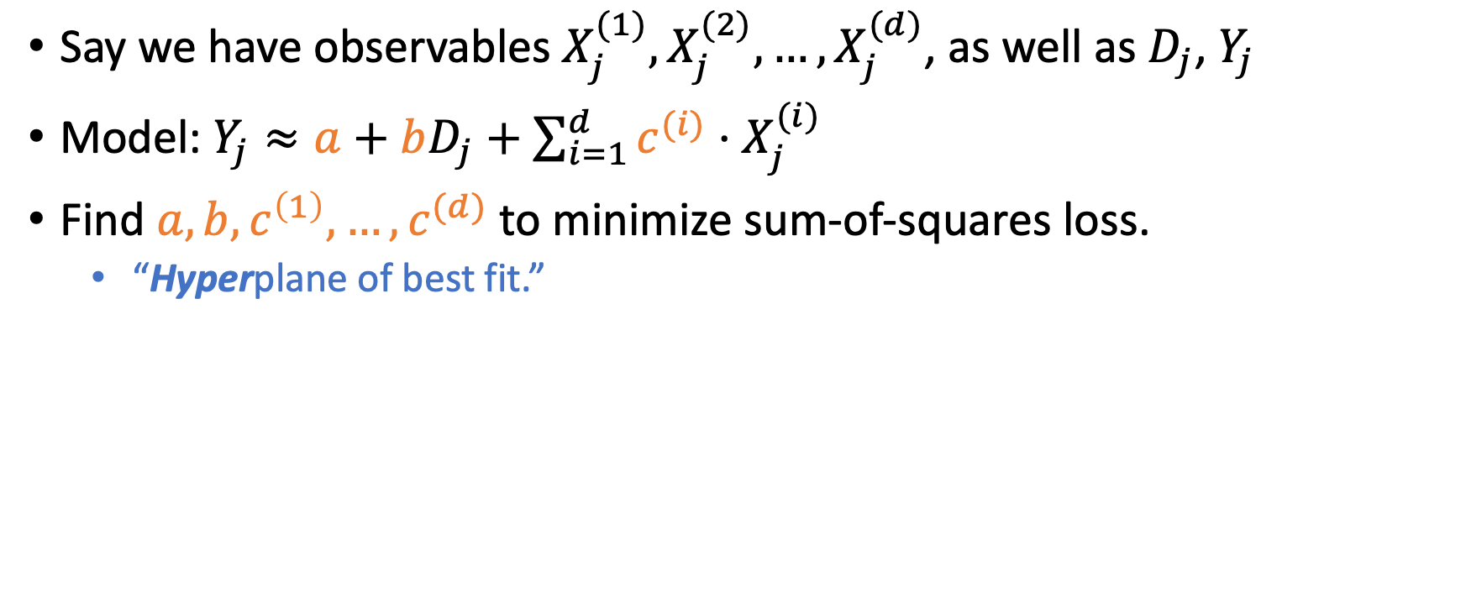
Even more generally
Say we have observables $X_{j}^{(1)}, X_{j}^{(2)}, …, X_{j}^{(d)}$, as well as $D_{j}$, $Y_{j}$
Model: $Y_{j}≈a+bD_{j}+\sum_{i=1}^{d}{c^{(i)}⋅X_{j}^{(i)}}$
Find $a,b,c^{\left(1\right)}, …, c^{(d)}$ to minimize sum-of-squares loss.
“Hyperplane of best fit.”

Slide 43

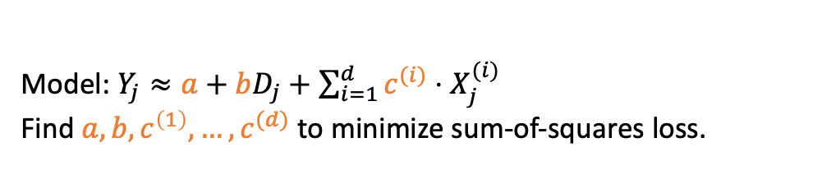

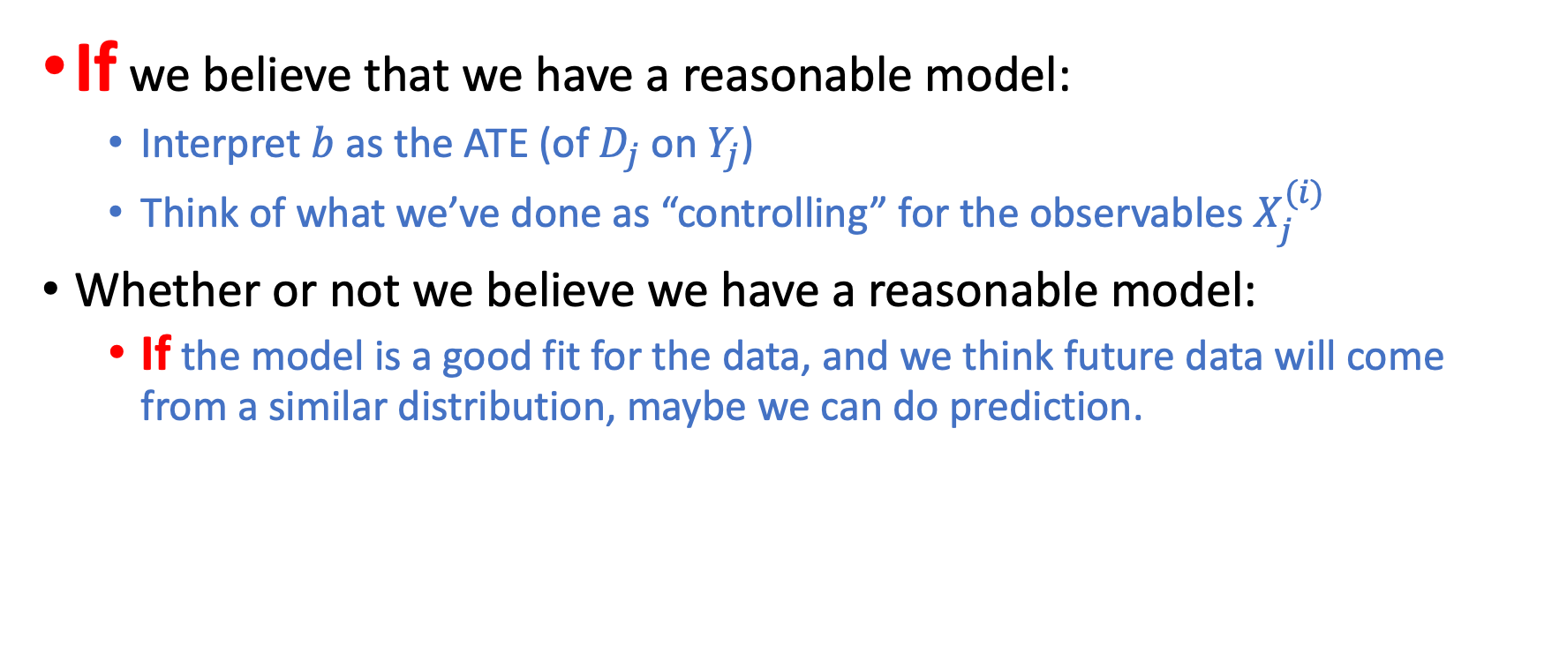

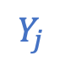
How to interpret regression
Model: $Y_{j}≈a+bD_{j}+\sum_{i=1}^{d}{c^{(i)}⋅X_{j}^{(i)}}$
Find $a,b,c^{\left(1\right)}, …, c^{(d)}$ to minimize sum-of-squares loss.
D
If we believe that we have a reasonable model:
Interpret $b$ as the ATE (of $D_{j}$ on $Y_{j}$)
Think of what we’ve done as “controlling” for the observables $X_{j}^{(i)}$
Whether or not we believe we have a reasonable model:
If the model is a good fit for the data, and we think future data will come from a similar distribution, maybe we can do prediction.
X
Y
$$Y_{j}$$
$$Y_{j}$$
Seems good!
Maybe not!
$$D_{j}$$
$$D_{j}$$

Slide 44
Example
Also see: your HW, for more examples!

Slide 45
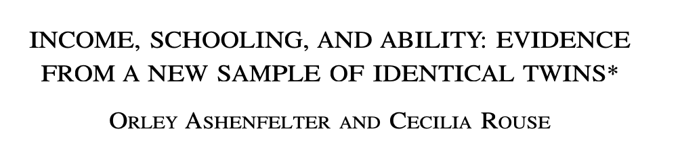
Published in 1998 in the Quarterly Journal of Economics
Orley Ashenfelter played a key role in many of the developments we have seen so far: he was Robert LaLonde’s advisor (whom we saw in HW2), and was David Card’s advisor (and senior colleague) and played a key role in the Card and Krueger paper we saw last class
Cecilia Rouse was the Chair of the Council of Economic Advisors under Biden. After a successful research career at Princeton, she was Dean of the School of Public and International Affairs, and is now the incoming president of the Brookings Institution.

Slide 46
Our usual question...
Note: We keep coming back to this example for consistency...but there are plenty of other questions that we can address with these techniques!
What are the returns to schooling?
Rather than running an RCT or finding a natural experiment, this paper tries to match on observables, using the best possible matching they can – twins!

Slide 47




The data: interviewing twins
The Twinsburg Twins Festival in Twinsburg, Ohio!

Slide 48


The data: interviewing twins

Slide 49
Also: Less interesting data
Current Population Survey (CPS)
A monthly survey of about 50,000 American households
Used to calculate the monthly unemployment rate
Also asks about earnings (occasionally, the survey has a slightly complicated structure)

Slide 50


Let’s run some regressions! So far nothing fancy about twins, just treat them as a normal data set
Outcome: $Y_{j}$ = log(hourly wage)
Variable of interest: $D_{j}$ = education (years)
Other Variables ($X_{j}^{(i)}$):
Age
Age² / 100
Female?
White?
$$Y_{j}≈a+b⋅D_{j}+c⋅Age_{j}+\frac{d}{100}⋅Age_{j}^{2}+e⋅Female_{j}+f⋅White_{j}$$

Slide 51

The results (and our first regression table)
This column: results with CPS data
This column: results with twins data
$$Y_{j}≈a+b⋅D_{j}+c⋅Age_{j}+\frac{d}{100}⋅Age_{j}^{2}+e⋅Female_{j}+f⋅White_{j}$$

Slide 52

The results (and our first regression table)
These numbers are the coefficients on $D_{j}$ in each data set.
This is the “b” in the model.
$$Y_{j}≈a+b⋅D_{j}+c⋅Age_{j}+\frac{d}{100}⋅Age_{j}^{2}+e⋅Female_{j}+f⋅White_{j}$$

Slide 53

The results (and our first regression table)
These numbers are the coefficients on ${Age}_{j}$ in each data set.
This is the “c” in the model.
$$Y_{j}≈a+b⋅D_{j}+c⋅Age_{j}+\frac{d}{100}⋅Age_{j}^{2}+e⋅Female_{j}+f⋅White_{j}$$

Slide 54
The results (and our first regression table)
Etc.
$$Y_{j}≈a+b⋅D_{j}+c⋅Age_{j}+\frac{d}{100}⋅Age_{j}^{2}+e⋅Female_{j}+f⋅White_{j}$$

Slide 55

The results (and our first regression table)
These numbers are the standard errors on the coefficient on $D_{j}$.
This is a measure of how “noisy” the estimate is. Smaller is better.
$$Y_{j}≈a+b⋅D_{j}+c⋅Age_{j}+\frac{d}{100}⋅Age_{j}^{2}+e⋅Female_{j}+f⋅White_{j}$$

Slide 56

The results (and our first regression table)
These numbers are the R² for the whole regression.
This is a measure of how much variance in $Y_{j}$ is explained by the model.
Large (close to 1) means that the model has lots of explanatory/predictive power (in the sample).
$$Y_{j}≈a+b⋅D_{j}+c⋅Age_{j}+\frac{d}{100}⋅Age_{j}^{2}+e⋅Female_{j}+f⋅White_{j}$$

Slide 57
The results (and our first regression table)
Take-aways:
Both data sets say that the returns to a year of education is an increase on the order of 10%.
Both look roughly the same on the other covariates (except “White”)
Maybe Twinsburg isn’t that weird a sample of people...
$$Y_{j}≈a+b⋅D_{j}+c⋅Age_{j}+\frac{d}{100}⋅Age_{j}^{2}+e⋅Female_{j}+f⋅White_{j}$$

Slide 58



Lets do another regression! This time with just the twins
Outcome: $Y_{j}$ = log(twin1 hourly wage) – log(twin2 hourly wage)
Variable of interest: $D_{j}$ = (twin1 years of ed.) – (twin2 years of ed.)
Other Variables...don’t matter since they are the same for twins!
This is using regression to do “matching on observables” in a different way than we saw before!
$$Δ$$
$$Δ$$
$$Y_{j}≈a+b⋅D_{j}$$

Slide 59








Lets do another regression! This time with just the twins
$$Δ$$
$$Δ$$
$$Y_{j}≈a+b⋅D_{j}$$
Outcome: $Y_{j}$ = log(twin1 hourly wage) – log(twin2 hourly wage)
Variable of interest: $D_{j}$ = (twin1 years of ed.) – (twin2 years of ed.)
Other Variables...don’t matter since they are the same for twins!
Result:
Take-away:
Similar order of magnitude as the previous regression (maybe a bit smaller*)
If we believe twins are identical in all relevant ways (even those we don’t observe), this suggests the effect is “causal.”

Slide 60
Do we believe this effect is causal? Is which twin got more education “random”?
Discuss!
What are some concerns?
How could you assess if these concerns are concerning?

Slide 61
Do we believe this effect is causal? Is which twin got more education “random”?
Biology suggests that lots is the same (these are identical twins)
They seem to have been treated similarly...
50% of twins had names that began with the same letter
27% had names that rhymed
Ask the twins!
Among female twins, the modal response had something to do with who got married/divorced
Among males, the modal response was that the two twins had different career interests
First-borns are different (tend to be larger, etc).
But, turns out, birth order has no predictive power for education (in this sample).

Slide 62

Look at other attributes (aka, possible confounders)
In the whole sample (if we forget whose twin is whose), education and spouse’s education are quite correlated.
If we only look at variation between identical twins, this correlation goes away.
(Even though the correlation between education and earnings did not).
Argument: if the twin with less education was “different” in some way, they’d have a “different” sort of spouse...but that’s not the case.

Slide 63
Recap: Example
When running a regression, look at standard errors and R²
In this example, the authors did not assume that the regression on the CPS data (general population) told them anything causal.
Even though regression ”controls” for observables.
However, they were convinced by a “matching” exercise using identical twins.
And, you can use regression to do that exercise too!

Slide 64
Recap: Regression
To deal with too many boxes...make some assumptions!
Linearity!
Regression: Find the best coefficients for a linear model.
If you want, think of these coefficients as telling you something about causality.
But be careful! Lots of assumptions!
If the model fits the data well, you can use these coefficients to do prediction.
D
X
Y

Slide 65
From Causality to Prediction
Next up:
And back again!
Regression!
D
Z
Y
Prediction-Land
Causality-Land

Slide 66
Propensity Scores

Slide 67
Recall the problem...

Slide 68
Issue: Too many boxes!
It’s lonely in here...
$10
No data
Say we do observe all/most important characteristics.
Say that’s like 50 characteristics.
That’s (at least) $2^{50}$ boxes...
$2^{50}$ = way bigger than the number of humans who have ever lived.
Most boxes are empty
Not enough samples in most boxes for “averages” to be meaningful.
Few pairs who are “identical on everything except college.”
Went to college
Dressing up
Age 30-35
Male
Married
Likes broccoli
...
Didn’t go to college
Dressing up
Age 30-35
Male
Married
Likes broccoli
...
$13
$3
$15
No data
$11
No data
No data
No data

Slide 69
Can we combine some of these boxes?
Yay, new friends!
$4
No data
$11
Went to college
Dressing up
Age 30-35
Male
Married
Likes broccoli
...
Went to college
Not dressing up
Age 15-20
Female
Unmarried
Doesn’t like broccoli
...
Went to college
Dressing up
Age 70-75
Female
Married
Doesn’t like broccoli
...
$7
$2
No data
If so, hopefully we’d get enough people in each “mega-box” that things work okay.
But how should we combine them?
No college
Dressing up
Age 30-35
Male
Married
Likes broccoli
...
No college
Not dressing up
Age 15-20
Female
Unmarried
Doesn’t like broccoli
...
No college
Dressing up
Age 70-75
Female
Married
Doesn’t like broccoli
...

Slide 70

Propensity Scores
The propensity score (for treatment $D_{j}$, given a set of observables) is:
$$𝔼\left[{ D}_{j} | observables other than D_{j} and Y_{j}\right]$$
Aka, what fraction of people in this pair of boxes went to college?
$10
$2
Went to college
Dressing up
Age 30-35
Male
Married
Likes broccoli
...
Didn’t go to college
Dressing up
Age 30-35
Male
Married
Likes broccoli
...
All of these things match up.

Slide 71
Propensity Scores
The propensity score (for treatment $D_{j}$, given a set of observables) is:
$$𝔼\left[{ D}_{j} | observables other than D_{j} and Y_{j}\right]$$
Aka, what fraction of people in this pair of boxes went to college?
How likely is it that someone with these observable characteristics goes to college?
$10
No data
Went to college
Dressing up
Age 30-35
Male
Married
Likes broccoli
...
Didn’t go to college
Dressing up
Age 30-35
Male
Married
Likes broccoli
...
All of these things match up.

Slide 72
Idea: Group people by propensity score
My probability of going go college based on my observable characteristics was between 60 and 70%.
What are you in for?
Hey me too!
No data
No data
No data
No data
No data
No college
College

Slide 73

Idea: Group people by propensity score
Not too many boxes! Plenty of people in each box!
Notation: $X_{j}$ = “observables” = “everything except $D_{j}$ and $Y_{j}$”
$$𝔼\left[{ D}_{j} | X_{j} \right]$$
...
0-10%
10-20%
20-30%
90-100%
Avg $6
Avg $8
Avg $15
Avg $20
...
Avg $11
Avg $12
Avg $17
Avg $21
...
Returns to college?
Average: $3.3 (say)
$5
$4
$2
$1

Slide 74
Why is this a good idea?
Consider our example before:
The issue was that the “costumed” and “un-costumed” groups had very different probabilities of going to college.
$1
$2
About $1
About $12
If we collapse the boxes:
Truth:
$11
$12

Slide 75
Why is this a good idea?
Suppose instead:
Now the “costumed” and “un-costumed” groups both have the same probability of going to college.
$1
$2
$5.5
$6.5
If we collapse the boxes:
Truth:
$11
$12
We estimate that the average returns to college is $1, which is correct!

Slide 76
Why is this a good idea?
If we combine a bunch of groups that all have the same probability of going to college...
Dressing up
Age 30-35
Male
Married
Likes broccoli
$1
$2
$9
$8
After lumping together:
Dressing up
Age 40-45
Female
Married
Likes broccoli
$11
$12
Truth:
Not dressing up
Age 40-45
Female
Single
Hates broccoli
$3
$4
We estimate that the average returns to college is $1, which is correct!
Not dressing up
Age 20-25
Male
Single
Hates broccoli
$17
$18

Slide 77
Sanity Check: What happens in an RCT? Better be the “good” case...
Everyone has the same propensity score!
Since everyone is equally likely to be in the treatment or control group!
Hooray!
This happens even if we don’t know all of the relevant observables!
Even better!
We can learn about the world without knowing about the world.

Slide 78
How do we get propensity scores?
This is a prediction problem!
Hey, we can use regression!
We’ll talk more in the next few classes about other ways to do prediction.
The odds that you attended college are... 58.3%
Here are a bunch of facts about me:
Dressing up for Halloween
American
Female
Age 25-30
Blood type O negative
Likes broccoli
...

Slide 79

Recap: Propensity Scores
Propensity score:
$𝔼\left[{ D}_{j} | observables other than D_{j} and Y_{j}\right]$
The probability that you get the treatment, given what we know about you.
If “what we know about you” is enough..
Put people into buckets based on propensity score
Compare people who did and did not get the treatment in the same bucket:
$𝔼\left[Y_{j} \left| prop. score≈0.7, D_{j}=1\right) \right] −$ $𝔼\left[Y_{j} \left| prop. score≈0.7, D_{j}=0\right) \right]$
This will determine expected the effect of $D_{j}$ on $Y_{j}$!
Big “if”!

Slide 80

Recap: Propensity Scores
Propensity score:
$𝔼\left[{ D}_{j} | observables other than D_{j} and Y_{j}\right]$
The probability that you get the treatment, given what we know about you.
If “what we know about you” is enough..
We can determine the expected the effect of $D_{j}$ on $Y_{j}$!
Aka, to establish causality, we need to solve a prediction problem!
Big “if”!
D
X
Y

Slide 81
Wrap-Up

Slide 82
Recap
D
X
Y
Regression!
In a linear model, find the line/plane/hyperplane of best fit.
Useful for both causal inference and prediction
if we believe that we have all the relevant observables, and that a linear model is appropriate, we can interpret regression coefficients as causal effects.
If a linear model seems to fit the data well, we can use regression coefficients to do prediction.
Propensity Scores!
If we believe that we can predict propensity scores accurately, we can use that to get a good matching estimator to establish causality.

Slide 83
Homework!
Practice with regression!
You’ll return to the datasets from HW2 and HW3!

Slide 84
That’s all!
See you next time, for even fancier linear-ish models!
SVD! PCA! OMG!

